Slide 1
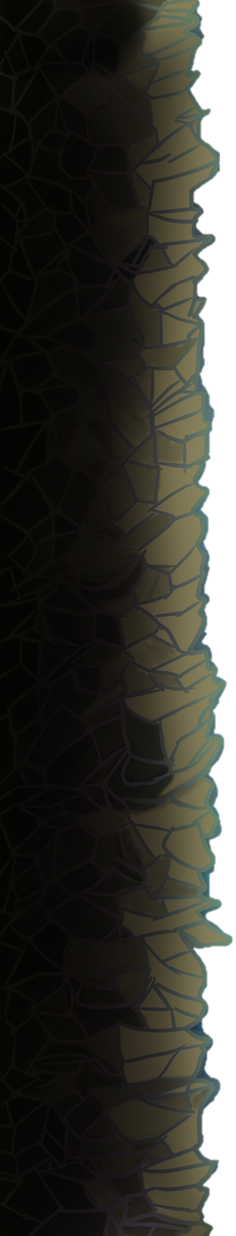
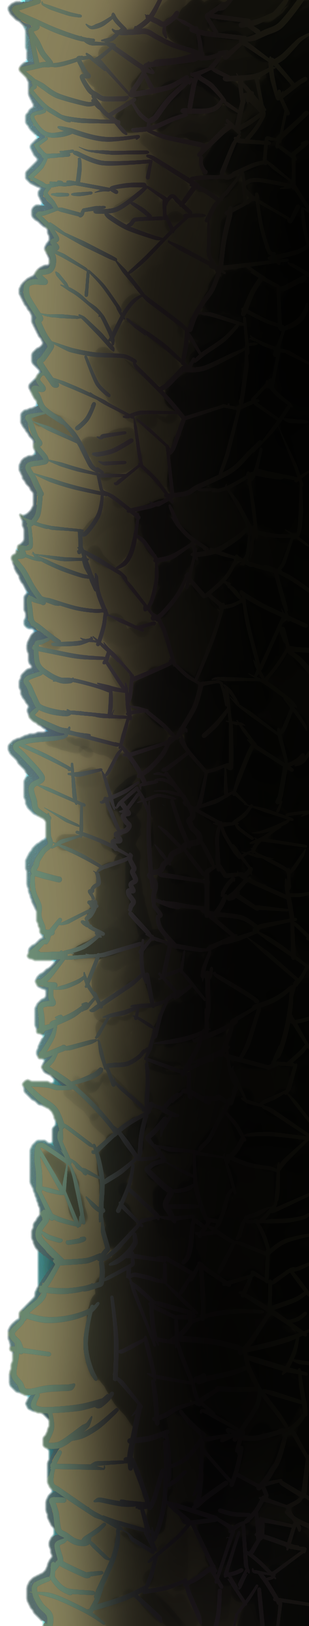


Crystal Drop
Dhruval Darji
Garret Mahan
Keenan Vasquez
Letisha MilleR

Slide 2
Drop It Like it’s…
Moment’s of Boredom
Travelling
Nothing to Do
Dropping in an Elevator
Notes:
Ever had moments of utter boredom where you are just waiting, or just plain have nothing to do. Travelling? Or even dropping in an elevator? What if I said that we have solved that problem?
You see, the goal of our study was to create an addictive, engaging game that users could enjoy. Something to stave off boredom in quick bursts.

Slide 3
A Game
Free Faller
Guide the Crystal Sentry
Progress through varying levels of difficulty
Touch and Tilt Controls
Collect Coins and get a High Score
Notes:
Ever had moments of utter boredom where you are just waiting, or just plain have nothing to do. Travelling? Or even dropping in an elevator? What if I said that we have solved that problem?
You see, the goal of our study was to create an addictive, engaging game that users could enjoy. Something to stave off boredom in quick bursts.

Slide 4
Research Questions
What kind of demand is there for a game of this type?
Are touch and tilt controls desirable to potential users?
Do gamers find the gameplay addictive or enjoyable?
What can we offer that other games cannot?
Is the user interface clear, concise and comprehensive?

Slide 5
Stakeholders
Anyone with moderate to high interest in
Casual
Quick-Play
Mobile Games
For Research Purposes
People around the ages of 20 – 30 with moderate interest in games.

Slide 6
User Research
Surveys → Concise
Online
Compiled as Raw Data
Interviews → Complex
In Person
Broad Range of Data

Slide 7
Study Evaluation
Surveys
Interviews

Slide 8
Results
Gender

Slide 9
Results
Ethnicity

Slide 10
Results
Gamer Level

Slide 11
Results
Game Time

Slide 12
Personas
Samuel: Casual - 61%
Age: 22 years
Gender: Male
Major: Computer Science
Ethnicity: African-American
Mobile OS: Android
Plays mobile games to pass the time while waiting or when bored.
Considers himself a casual mobile gamer.
Does not enjoy mobile gaming as a primary source of entertainment.
Mixed feelings toward tilt controls.

Slide 13
Personas
Chloe: Mid-Core - 28%
Age: 23 years
Gender: Female
Major: Game Design
Ethnicity: Caucasian
Mobile OS: Android
Plays mobile games for fun and personal achievement.
Considers herself a mid-core gamer.
Enjoys mobile gaming as a hobby.
Least likely to play competitively

Slide 14
Personas
Nathan: Hardcore - 11%
Age: 22 years
Gender: Male
Major: Mechanical Engineering
Ethnicity: Caucasian
Mobile OS: iOS
Is looking for his new game addiction.
Considers himself a hard-core gamer.
Enjoys mobile gaming as a hobby.
Dislikes some competitive elements; hates seeing how bad he is.

Slide 15
Design Requirements
Supports Android and iOS
Game continues until the player dies
Incorporates touch and tilt controls
Must feel natural
Incorporates a High Score system
Various enemies and Zones

Slide 16
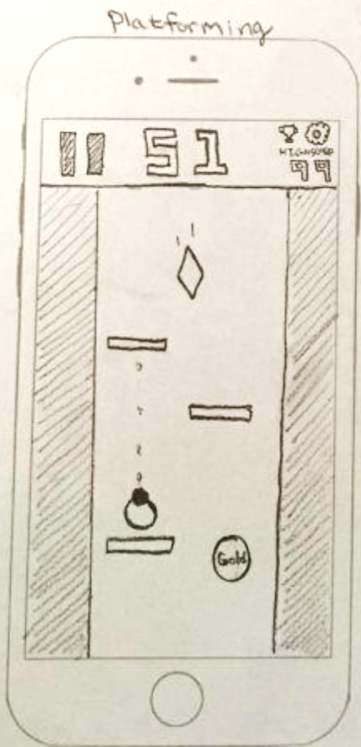
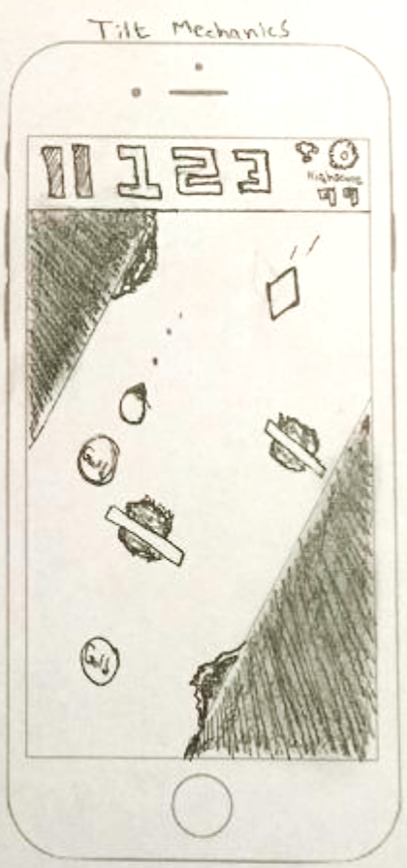
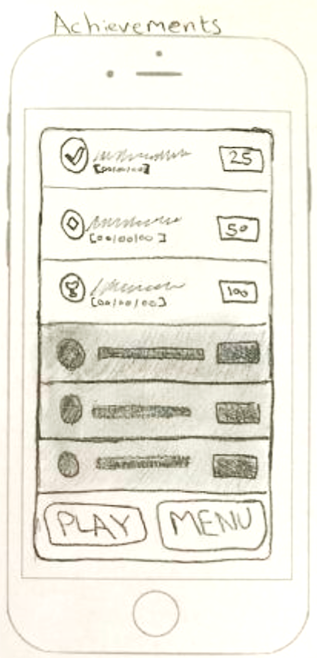
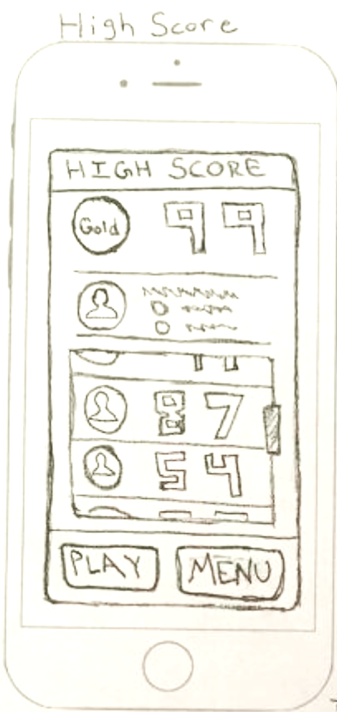
Sketches

Slide 17
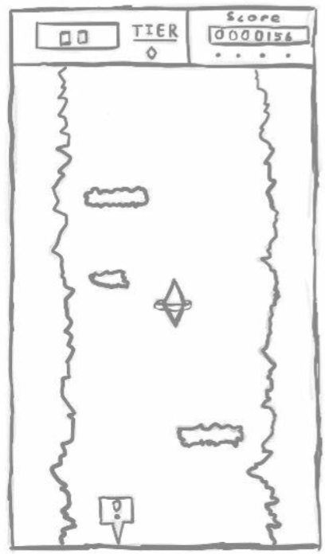
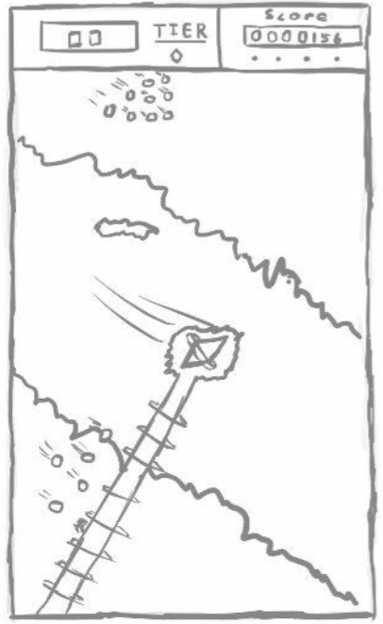
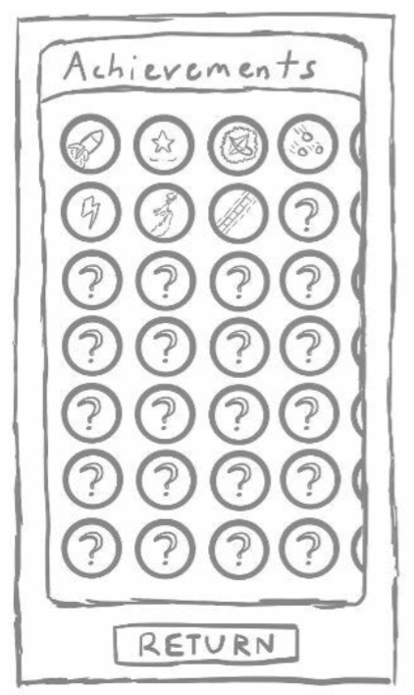
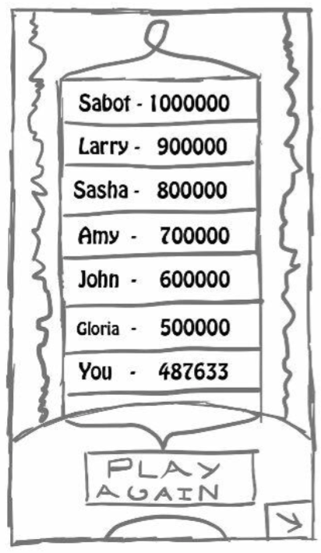
Sketches

Slide 18
Prototype

Slide 19
Future and Reflection
Larger Studies
More Diverse Population
Proper Development and Versioning Coordination

Slide 20
Questions?

